Slide 1
Programmer
Maths in the workplace

Slide 2
How our teaching resources are designed for the classroom

Slide 3
I can understand how maths is used by programmers.

Slide 4
A (computer) programmer is a person who writes and tests computer programs.

Slide 5

Programmer
Algorithms
Logic

Slide 6
Algorithms
An algorithm is a set of instructions which can be carried out to solve a problem.
Programmers write algorithms that a computer can follow to solve problems.
The instructions are followed in order by the computer.

Slide 7
Algorithms
Here is an algorithm for finding the absolute difference between any two numbers:
1) Take two numbers, a and b, where a > b
2) Calculate a − b
3) The result is the absolute difference

Slide 8
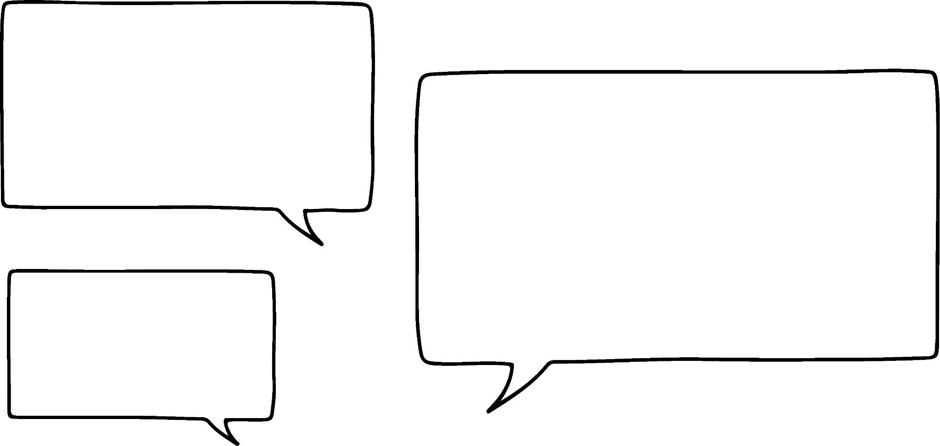


Algorithms
Here is an algorithm for finding the absolute difference between any two numbers:
1) Take two numbers, a and b, where a > b
2) Calculate a − b
3) The result is the absolute difference
I used 9 and 17 and got the answer −8
I used 9 and 17 and got the answer 8
Who is right?
Jacob
Alex

Slide 9

Algorithms
Here is an algorithm for finding the absolute difference between any two numbers:
1) Take two numbers, a and b, where a > b
2) Calculate a − b
3) The result is the absolute difference
17 − 9
I used 9 and 17 and got the answer −8
I used 9 and 17 and got the answer 8
Who is right?
Jacob
Alex

Slide 10


Algorithms
Instructions have to be clear.
I need some help with my homework. Laura, can you please take a look at my work?
Sure thing Lucas.
Lucas
Laura

Slide 11
Algorithms
Instructions have to be clear.
Laura! You said you would help me and I got all my work wrong!
You asked me to take a look and I did. You didn’t ask me to help you correct your work.
Lucas
Laura

Slide 12
Algorithms
In reality, Laura would have helped Lucas correct his work because she can infer what Lucas meant from his question.
A computer cannot do this and therefore programmers need to be very careful with the instructions they give.

Slide 13
Algorithms
Algorithm 1
Step 1: Take two positive numbers, A and B.
Step 2: Draw a table with two columns. Put A at the top of the left column and B at the top of the right column.
Step 3: In the next row, in the left-hand column write the number that is half of A (ignoring remainders) and in the right-hand column write the number that is double B.
Step 4: Repeat Step 3 until you have a 1 in the left-hand column.
Step 5: Delete any rows where the left-hand column has an even number.
Step 6: Find the sum of the numbers left in the right-hand column.

Slide 14
Algorithms
1) Carry out algorithm 1 with the following numbers:
a) A = 8, B = 10
b) A = 29, B = 34
c) A = 13, B = 17
d) A = 66, B = 56
2) What does algorithm 1 do?

Slide 15
Algorithms
3) Write an algorithm for making a drink of squash or a cup of hot chocolate (more challenging). Give your algorithm to a partner and let them try to ‘break’ your algorithm. Is there a way for them to misinterpret your instructions?

Slide 16
Algorithms
Algorithm 1
Step 1: Take two positive numbers, A and B.
Step 2: Draw a table with two columns. Put A at the top of the left column and B at the top of the right column.
Step 3: In the next row, in the left-hand column write the number that is half of A (ignoring remainders) and in the right-hand column write the number that is double B.
Step 4: Repeat Step 3 until you have a 1 in the left-hand column.
Step 5: Delete any rows where the left-hand column has an even number.
Step 6: Find the sum of the numbers left in the right-hand column.

Slide 17
Algorithms
1) Carry out algorithm 1 with the following numbers:
a) A = 8, B = 10
8 | 10
4 | 20
2 | 40
1 | 80
The sum of the remaining numbers in the right-hand column is 80

Slide 18
Algorithms
1) Carry out algorithm 1 with the following numbers:
b) A = 29, B = 34
29 | 34
14 | 68
7 | 136
3 | 272
1 | 544
The sum of the remaining numbers in the right-hand column is 986

Slide 19
Algorithms
1) Carry out algorithm 1 with the following numbers:
c) A = 13, B = 17
13 | 17
6 | 34
3 | 68
1 | 136
The sum of the remaining numbers in the right-hand column is 221

Slide 20
Algorithms
1) Carry out algorithm 1 with the following numbers:
d) A = 66, B = 56
66 | 56
33 | 112
16 | 224
8 | 448
4 | 896
2 | 1792
1 | 3584
The sum of the remaining numbers in the right-hand column is 3696

Slide 21
Algorithms
1) Carry out algorithm 1 with the following numbers:
a) A = 8, B = 10 80
b) A = 29, B = 34 986
c) A = 13, B = 17 221
d) A = 66, B = 56 3696
2) What does algorithm 1 do?
The algorithm calculates the product of the two numbers.

Slide 22
Algorithms
3) Write an algorithm for making a drink of squash or a cup of hot chocolate (more challenging). Give your algorithm to a partner and let them try to ‘break’ your algorithm. Is there a way for them to misinterpret your instructions?
E.g. There were lots of possibilities here. Hopefully you had lots of fun ‘breaking’ algorithms. Here are some examples of ways you could have done this:
‘Fill the kettle with water’ - this could mean put in water until it reaches the very top of the kettle (water will escape when the kettle boils)
- where does the water come from? (tap, toilet?!)

Slide 23
Programmer
Algorithms
Logic

Slide 24
Logic
Logic is about using reasoning to determine whether something is true or untrue. This is usually done through a series of statements.
For example:
Andeep is taller than Aisha and Aisha is taller than Sarah.
What can you reason about Andeep and Sarah?

Slide 25
Logic
Logic is about using reasoning to determine whether something is true or untrue. This is usually done through a series of statements.
For example:
Andeep is taller than Aisha and Aisha is taller than Sarah.
What can you reason about Andeep and Sarah?
Andeep must be taller than Sarah.

Slide 26
Logic
You must be careful to not infer from a statement.
‘If today is Saturday, then I will go to the beach’
Think about what this statement tells us about the day of the week and what I might be doing.

Slide 27
Logic
‘If today is Saturday, then I will go to the beach.’ What can you conclude if:
I will go to the beach.
Today is Saturday.
Today is not Saturday.
Nothing new.
I’m going to the beach today.
Nothing new.
It is not Saturday.
I did not go to the beach today.

Slide 28
Logic
Logic can help us find contradictions.
At Oak National Academy, it is logic day. On logic day, all pupils either always tell the truth or always lie.

Slide 29


Logic
You first meet Aisha and Andeep.
We are both lying today.
Is Aisha lying today? What about Andeep?

Slide 30
Logic
You first meet Aisha and Andeep.
We are both lying today.
If Aisha is telling the truth, then she is lying today - contradiction. Therefore Aisha is lying. Her statement is not true.

Slide 31
Logic
You first meet Aisha and Andeep.
We are both lying today.
Not true.
Since Aisha is not telling the truth, we know that Andeep cannot be lying today. Andeep is telling the truth today.

Slide 32
Logic
You now meet Alex and Izzy. Alex says, ‘Exactly one of us is lying today.’ Is Izzy telling the truth today?
Yes
No
Not enough information

Slide 33
Logic
You now meet Alex and Izzy. Alex says, ‘Exactly one of us is lying today.’ Is Izzy telling the truth today?
If Alex is telling the truth, then Izzy must be lying today.
If Alex is lying then there cannot be only one person lying today. Therefore Izzy must also be lying.
Conclusion - it doesn’t matter whether Alex is telling the truth or lying, Izzy must be lying today.

Slide 34
Logic
1) ‘If it is raining, I will use an umbrella.’
What can you conclude if:
a) It is raining.
b) It is not raining.
c) I am using an umbrella.
d) I am not using an umbrella.

Slide 35
Logic
2) At Oak National Academy, it is logic day. On logic day, all pupils either always tell the truth or always lie.
You meet Jacob and Jun. Jacob says, ‘Exactly one of us is telling the truth today.’
Is it possible to state whether Jacob is telling the truth or not?

Slide 36
Logic
3) At Oak National Academy, it is logic day. On logic day, all pupils either always tell the truth or always lie.
You meet Laura and Lucas.
Laura says, ‘I am lying today and Lucas is telling the truth today.’
What can you deduce, if anything, about Laura and Lucas?

Slide 37
Logic
4) At Oak National Academy, it is logic day. On logic day, all pupils either always tell the truth or always lie.
You meet Sam and Sofia.
Sam says, ‘One of us is lying and one is telling the truth.’
Sofia says, ‘We are both doing the same thing and I am lying.’
What can you deduce, if anything, about Sam and Sofia?

Slide 38
Logic
1) ‘If it is raining, I will use an umbrella.’
What can you conclude if:
a) It is raining. I will use an umbrella.
b) It is not raining. Nothing new.
c) I am using an umbrella. Nothing new.
d) I am not using an umbrella. It is not raining.

Slide 39
Logic
2) At Oak National Academy, it is logic day. On logic day, all pupils either always tell the truth or always lie.
You meet Jacob and Jun. Jacob says, ‘Exactly one of us is telling the truth today.’
Is it possible to state whether Jacob is telling the truth or not?
No. We can work out that Jun must be lying today but we don’t know whether Jacob is telling the truth or not.

Slide 40
Logic
3) At Oak National Academy, it is logic day. On logic day, all pupils either always tell the truth or always lie.
You meet Laura and Lucas.
Laura says, ‘I am lying today and Lucas is telling the truth today.’
What can you deduce, if anything, about Laura and Lucas?
Laura and Lucas are both lying today.
For Laura to be telling the truth, every part of her statement must be true. One part being a lie is enough to know she is lying today.

Slide 41
Logic
4) At Oak National Academy, it is logic day. On logic day, all pupils either always tell the truth or always lie.
You meet Sam and Sofia.
Sam says, ‘One of us is lying and one is telling the truth.’
Sofia says, ‘We are both doing the same thing and I am lying.’
What can you deduce, if anything, about Sam and Sofia?
Sam is telling the truth and Sofia is lying.

Slide 42
Programmer
A (computer) programmer is a person who writes and tests computer programs.
An algorithm is a set of instructions which can be carried out to solve a problem. Programmers write algorithms that a computer can follow to solve problems.
The instructions should follow logically.

Slide 43

© Oak National Academy 2024.
Produced in partnership with Mathematics in Education and Industry.
Licensed on the Open Government Licence v3.0, except where otherwise stated. See Oak terms and conditions.

